Slide 1
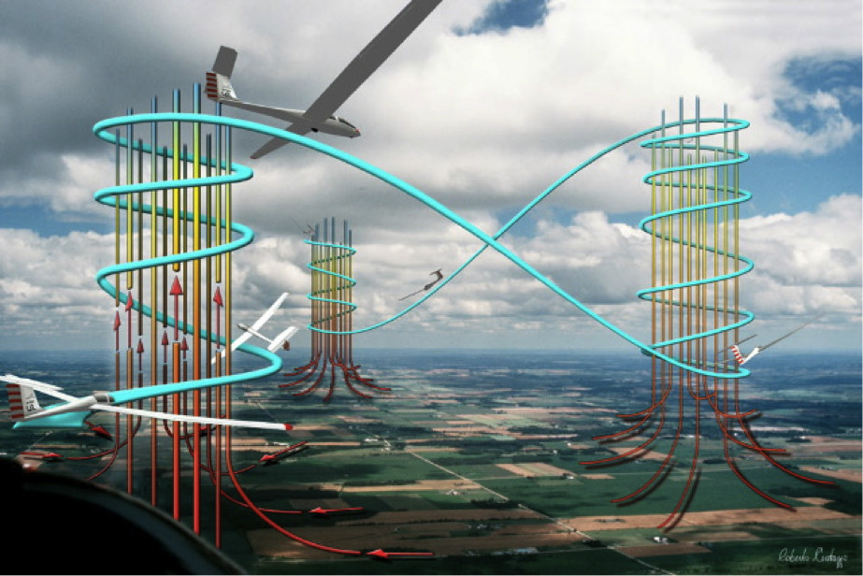
Thermalling Skills -2
Larry Suter
Air Sailing Thermal Camp
June 7, 2016

Slide 2
Earlier today and yesterday we provided answers to fundamental questions of thermalling:
Where should I be looking to find a thermal?
Is this a thermal?
If you’re in lift for 3 seconds, assume it’s a thermal
When should I begin turning?
After you’ve been in lift for 3 seconds
Which way should I turn?
The set of rules tells you
How do I go about “centering” the thermal (be in strong lift the entire circle)?
Roll out on a rising, positive vario, then roll back in again
The roll-out, roll back in should take about three seconds

Slide 3
Mark Montague’s 5 Rules For Deciding Which Way to Turn:
(simply go down the list and apply the first rule that applies)
1) If close to high terrain, turn away from the terrain
--you don’t want to collide with the terrain, nor do you want (if low)
to drift downwind and into the sink beyond the crest
2) If close to other traffic, turn so as to minimize the collision risk
--this includes matching the turn direction in use by another glider
already climbing in the thermal you’re about to use
3) If you sense one wing being lifted by the thermal, turn toward that wing
--the thermal core is likely to be in that direction
4) If you’re on a generally cross-wind heading, turn into the wind
--the upwind edge is likely to be the strongest part of the thermal
5) If no other rule applies, recall what direction you turned in the last thermal you used, and turn the opposite way
--you want to develop equal facility with turns in either direction

Slide 4
Another important question that you’ll need to answer at least once each soaring day is,
“When do I get off tow?”

Slide 5
Mark Montagues two step process for deciding when to release on a day when thermals are working
1- Be above some minimum, predetermined altitude
(e.g. “I will not release until I am at least 2500’ AGL”)
2- Reject any apparent thermal that lasts for less than 5 seconds
The decision to pull the release is irreversible
There’s a good chance this is the closest to landing that you will be for your entire flight
But wait a minute… On aerotow my vario’s almost always indicating “Up”
How do I know I’m in a thermal?
Get to know your glider’s rate of climb behind a given towplane without lift
(often ~4-6 kts)
When your vario indicates much higher than that, you’re in lift

Slide 6
Mark writes,
Too many pilots decide, before they even take off, to release at some
arbitrary altitude. They’ll fly through a great thermal at 2500 feet, fly
out of it at 2800 feet, then release in sink at 3000 feet—and turn
around and try to find that thermal again. Good luck!
A much better strategy is to set a “floor” altitude below which we won’t release, then release in the first good thermal we encounter above that floor, during which we experience good lift for at least 5 seconds.
Mark continues,
Not only will the technique of releasing in the first good 5-sec thermal encountered
after reaching your floor for the day save you money, it will also enable your
buddies back on the ground to get airborne sooner, too—and you’ll find it’s easily
the fastest, easiest way to get your flight off to a good start.

Slide 7
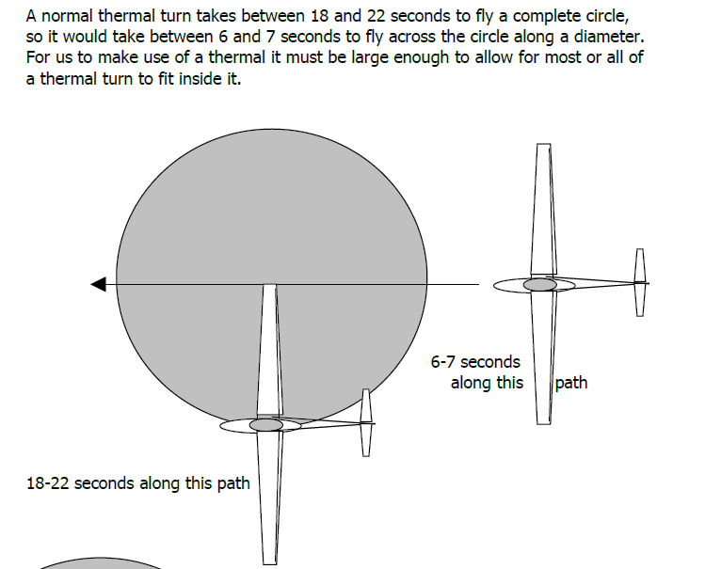
We’ve been saying that a thermalling turn should take 18-22 seconds
This number comes from the size of a typical thermal

Slide 8
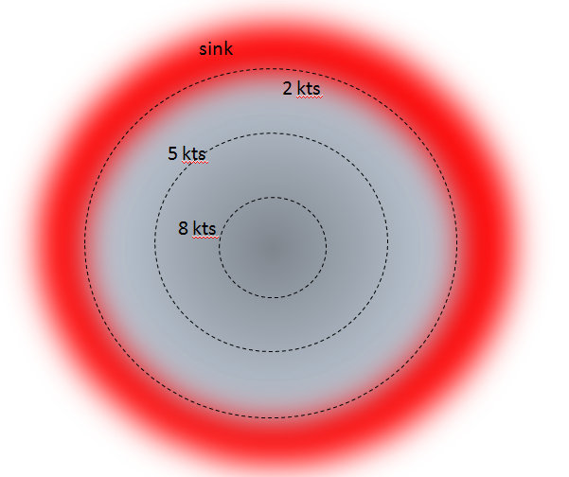
The “diametrical scalelength” of a Great Basin Thermal’s column is on the order of 500’ (150 meters)
“Mushroom cap” of larger diameter that’s net rising
Mostly a narrow column of rising air
Pool of hot air being depleted
~150 m

Slide 9
The unshaded portions of this table are speed/bank angle combinations that give a 150 meter, or so, diameter circle

Slide 10
The speed/bank angles that give this approximately 150 meter circle correspond to a circle time of 18-20 seconds

Slide 11
This is why we’ve been saying

Slide 12
Set as a goal to leave thermal camp able to fly approximately constant speed and bank circles that take about 18-22 seconds
Today, time a few of your circles
You’ll probably find it easier to circle at 50-55kts rather than 45
With more practice you’ll be able to get smaller diameter circles later this summer

Slide 13
The shaded areas are circles with diameters >~800’ . This big a circle is not going to get you climbing fast

Slide 14
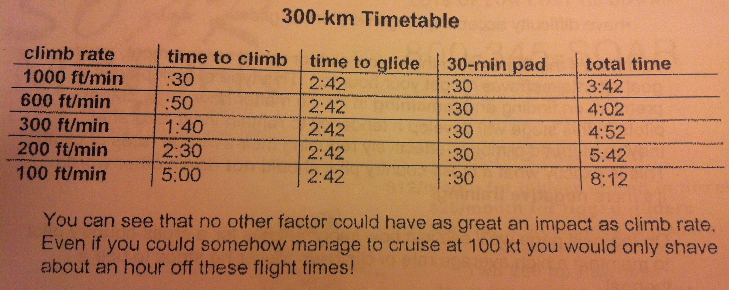
We just said that “Circles 800’ are not going to get you climbing fast.” Why should we care about climbing fast?
It’s because “the single factor which influences cross-country speed that the pilot can do the most about is the rate of climb”- M. Teeter

Slide 15
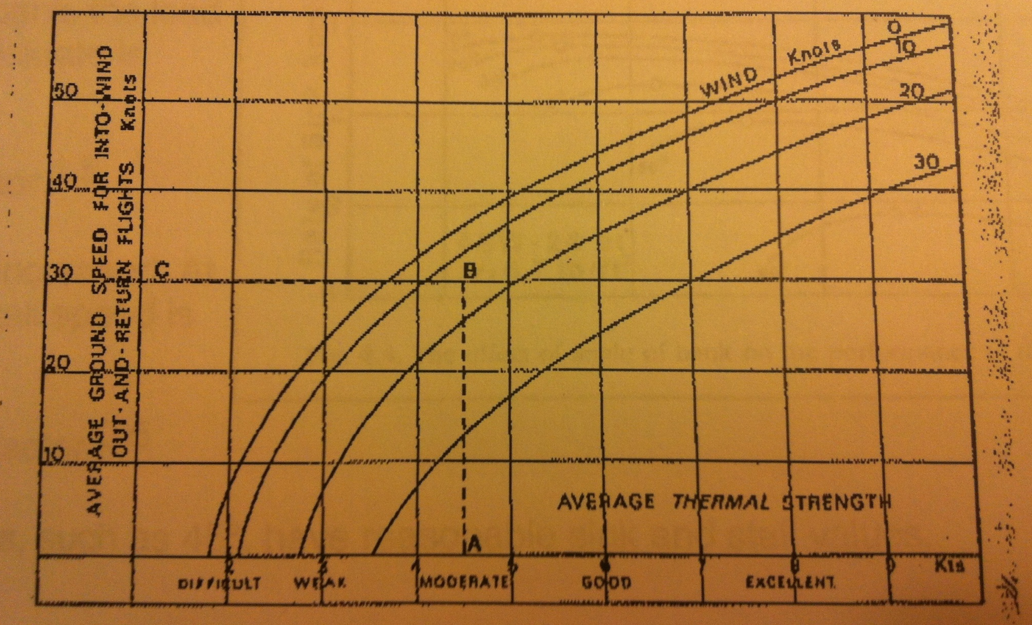
“The single factor which influences cross-country speed that the pilot can do the most about is the rate of climb”

Slide 16
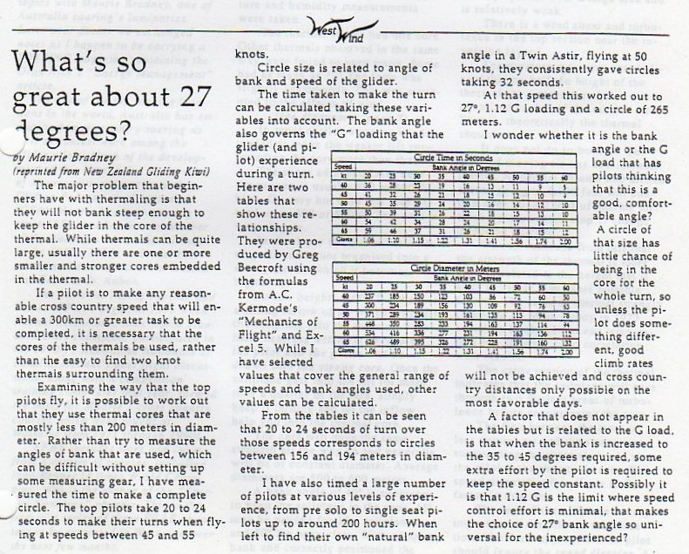

Slide 17
At this camp and throughout this summer, actively work on:
Getting your thermalling circles down to about 20 seconds with good speed control
Once you’ve found a thermal, efficiently centering it with this ~20 second circle to allow you to climb rapidly

Slide 18
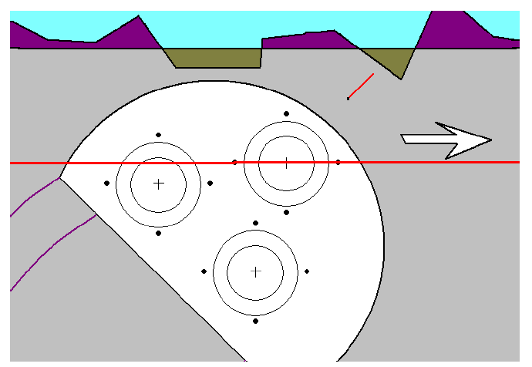
BTW, the screws fastening your instruments to the panel are a useful tool for estimating bank angle
When diagonally opposite screws are parallel to the horizon, you’re at 45 degrees

Slide 19
Yesterday we talked about using the rise of the vario as our cue to roll out
sink
Wind
2 kts
5 kts
8 kts
3 sec
Vario rising and >0
We use the rise of the vario as our cue to roll out and not absolute vario values because of “variometer lag”

Slide 20
Varios don’t respond instantaneously.
Mechanical varios (flow of air from static port to a “flask” via a small orfice) have a time constant ~3 seconds (old equipment) to ~1.5 seconds (modern mechanical vario)
Your vairo’s “time constant” is defined as the length of time the instrument takes to reach 65 % of its final reading in response to a sudden change in vertical speed. The time constant serves as a standard for gauging speed of response of different varios.
Electronic varios (Pressure transducer+computer) can have time constants as small as 0.5 sec
Cambridge L-nav has three settings: 0.6 sec, 0.9 sec and 1.5 sec
Newer, Tasman varios have adjustable time constants of 1 to 4.5 seconds
Pilots tend to prefer the faster time constant. That’s my opinion
If you have an electronic vario, learn how to change the time constant and experiment with the settings.

Slide 21
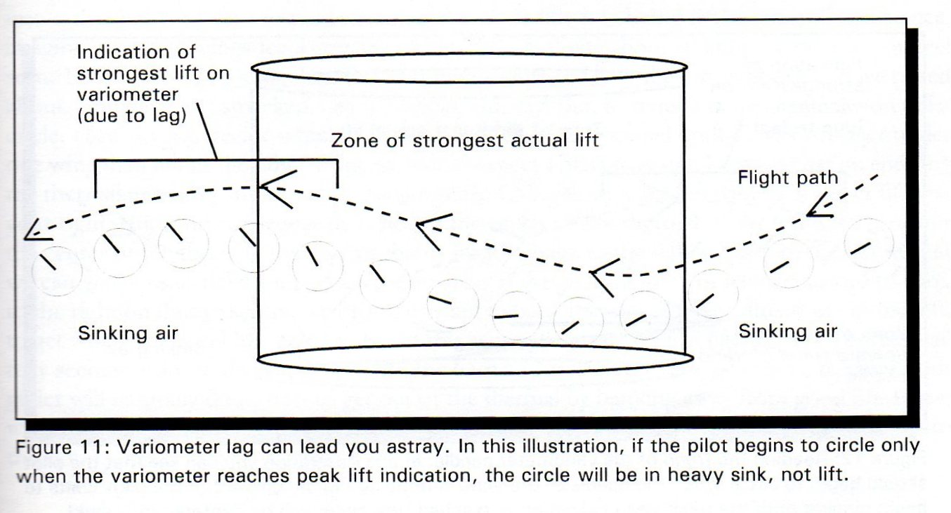
This cartoon from Bob Wanders’ Thermalling Made Easy shows how a vario with a long time-constant can be misinterpreted

Slide 22
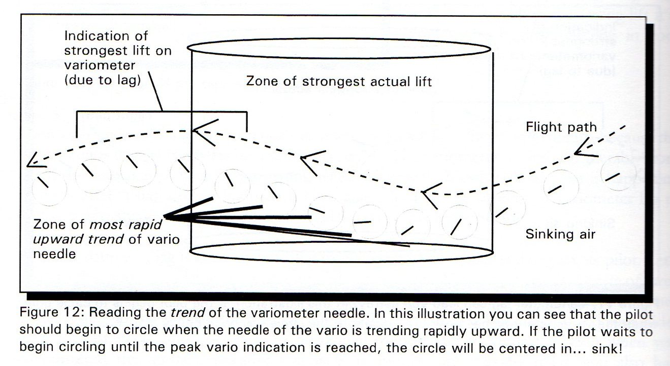
If you have a vario with a long time-constant you’ll be better off responding to the trend of the vario’s needle

Slide 23
When doing 18-21 second thermalling circles, you’re turning at about 20 degrees per second
With a 3 second time constant, the information from your vario represents what was going on some 60 degrees ago
With a 1 second time constant, it’s about 20 degrees ago

Slide 24
Excellent article on thermaling from Soaring, February, 1992 with emphasis on using changes in the vario to center a thermal

Slide 27
Real thermals are not always (rarely?) uniform in cross-section
sink
2 kts
5 kts
8 kts
For many reasons: eg, two nearby thermals merging with altitude

Slide 28
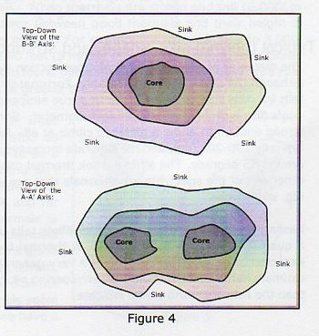
Hertenstein provides these sketches illustrating how lift might be distributed in an area where several nearby thermals were triggered from the same reservoir of hot air
While attempting to center the thermal you should also be “forming a mental picture” of the thermal’s cross-section. Once you have that picture, use that to roll-out and roll-in
Be ready to revise your mental picture of the thermal. Not necessarily because you were wrong, but because the thermal changes with height.

Slide 29
And remember, the lift cross-section changes near the top, even in an idealized thermal
Be ready to revise your mental picture of the thermal. Not necessarily because you were wrong, but because the thermal changes with height.
Fluid
Temperature on left
A metric of Turbulence on the right
https://www.youtube.com/watch?v=54Dm3lMwIL4

Slide 30
Practice: Assume each of these thermal cross-sections is “12 seconds by 20 seconds” in size
Imagine yourself having just entered one of these thermals at any point, flying straight.
Draw the line. If it’s 3 sec long, start thermalling. Then apply Petmecky’s rules based on instantaneous changes of the vario

Slide 31
First turn

Slide 32
Second turn

Slide 33
Common Soaring errors from an article by Richard Kellerman in November, 2000 Soaring

Slide 34
Suggested in-flight thermalling exercises for today
Continue to time a few of your circles today. Note the approximate average airspeed. Use the table to get an average bank angle
Set as a goal to leave thermal camp able to fly approximately constant speed and bank circles that take about 18-22 seconds
If you’re having trouble centering thermals with the 270 degree technique which requires you to estimate where peak lift rate is, try Petmecky’s technique with which you to respond to variometer changes

Slide 35
Do Reichmann’s Thermalling Exercise #1

Slide 36
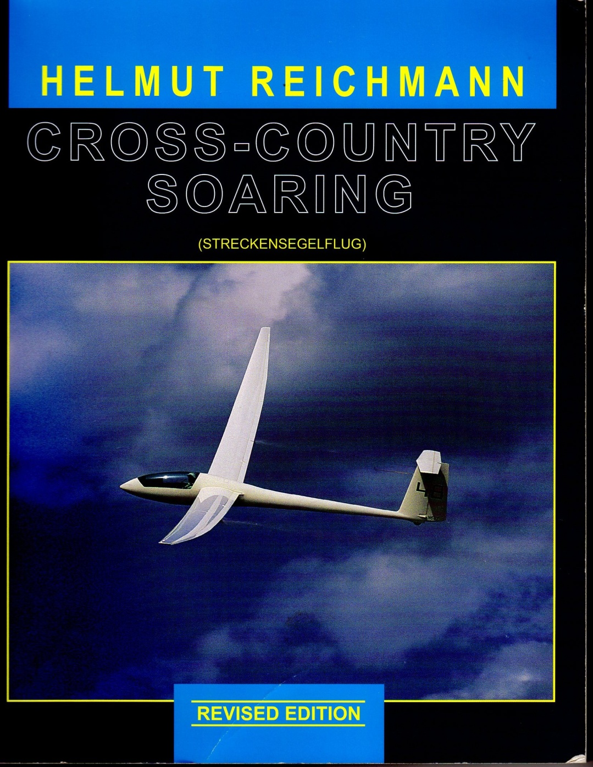
One of many exercises in Reichmann’s Cross-Country Soaring

Slide 37
